Slide 1
Meditation
What, Why, How
Notes:
https://www.youtube.com/watch?v=YLO7tCdBVrA

Slide 2
What is meditation?
meditate
intransitive verb
1:to engage in contemplation or reflection He meditated long and hard before announcing his decision.
2:to engage in mental exercise (such as concentration on one's breathing or repetition of a mantra) for the purpose of reaching a heightened level of spiritual awareness
transitive verb
1:to focus one's thoughts on :reflect on or ponder over He was meditating his past achievements.
2:to plan or project in the mind :intend, purpose He was meditating revenge.

Slide 3
Okay, but what is meditation?
Meditation is a practice
Meditation has a goal (of some kind)
Meditation is unique to each person
It can be used for a variety of reasons, and accomplished in a variety of ways.
Meditation can be used to change modes of consciousness, potentially transcendence

Slide 4
Why would I want to meditate?
To clear your mind
To work through a problem
To find inspiration
To calm your mind and body
Research shows that fight or flight reactions (in the amygdala) are significantly reduced by regular mindfulness practices
To commune with your spiritual body
Notes:
Research: The amygdala, the “fight or flight” part of our brains, is less reactive after thirty or so hours over eight weeks of Mindfulness-Based Stress Reduction practice. From https://www.mindful.org/style-meditation-best/

Slide 5
Okay, so how do I do this thing?
Sit with your back perfectly straight
Breathe only through your nose
Clear your mind of all thought
Focus on the one area you want help with
Place your hands in the appropriate mudra
Just kidding…
While that is one way to meditate, it’s most certainly not the only one!
There are those who would tell you that it’s all about visualization – this is a personal choice!
Notes:
If you’re struggling with keeping a straight back posture, make sure you are supporting your back with your ABS. (tummy)

Slide 6
What’s Visualization?
Using your “mind’s eye” to see or create something.
For instance, if I say “visualize a cone of ice cream,” you should be able to see a cone of ice cream in your head, even if you don’t have one in front of you.
The more general the image, the more personal the visualization. “Visualize ice cream”
If you want something specific, visualize the specifics*
It doesn’t need to be pictures. If I say “Ice Cream” and you see the words floating in front of you, or on a piece of paper in the air in front of you, that’s a visualization.
You will often see or hear “visualize <this thing>” during meditations or in instructionals.
Visualization doesn’t work for everyone, and it’s okay. Not everyone loves guided meditation for that very reason.
Notes:
Image from TNT’s The Librarians
Visual or not? Not everyone is able to envision images, even in guided meditation. There are other ways to visualize that isn’t imagery based.
This is a good place to have a discussion about what it means to Visualize something and how that can work, if your group likes to discuss stuff.
Visualize actual images; visualize words; visualize yourself in a situation that reflects what you want. Even in Harry Potter, what’s in your head matters. Ridikkulus!
* General rule: don’t be too specific with goals / requests for help.

Slide 7
How do I pick?
The first question you should ask yourself:
What do I want to get out of this?
Then, ask yourself:
What will be the most effective way to achieve this?
And hopefully, you don’t pressure yourself with:
How long will it take to get an answer?

Slide 8
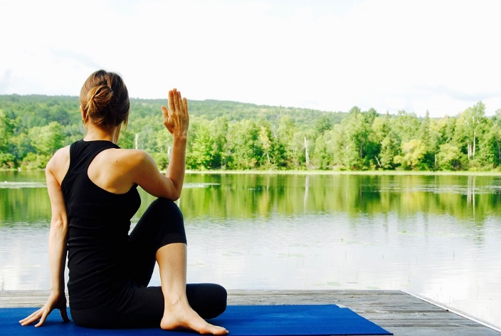
So, really – how??
There are many types of meditation:
There’s the yoga style meditative practice hinted at in the previous slide
Mindfulness meditation
Mindfulness-Based Stress Reduction
Retreat
Insight (or “inner work”)
Guided Meditation
Wandering (Aimless Wandering)
Notes:
Photo Credit
http://maxpixel.freegreatpicture.com/Woman-Yoga-Meditation-Landscape-Nature-Meditate-1812695

Slide 9
What type of meditation makes sense to you?
Ask yourself…
Then you might try…
Are you able to sit still and not talk for hours?
Do you have a moving mind that needs a change in scenery?
Do you love to drive?
Are you able to get away to a retreat center?
Do you have problems maintaining focus, or do you NEED visualization?
Yoga
Aimless Walking (wandering) or Astral Projection
Aimless Driving (or less aimless, but still..)
Retreat / any type that speaks to you
Guided Meditation

Slide 10
But, what if…
What if my mind wanders?
What if I don’t have a lot of time?
What if I don’t know what I’m doing?
What if I’m doing it wrong?
Don’t worry about “what if” questions!

Slide 11
What if my mind wanders?
If your mind wanders back to the grocery list, or on to a to-do list, or remembering that thing that happened with that one girl that one time, just acknowledge the thought and let it go.
Meditation shouldn’t be stressful – that’s kinda contrary to the idea
Notes:
Acknowledge the thought, and file it away for later if it’s important, or let it go if it’s not. Letting things go is hard, but is a good practice. Sometimes a visualization like letting the thing go, swept away by wind, or carried away by water, or burnt up by fire, etc. is helpful.

Slide 12
What if I don’t have a lot of time?
Depending on what you really want from your practice, you don’t NEED a lot of time!
Check out an app or two
Watch a video on Youtube
The Fitbit has a 2-20 minute “mindfulness” breathing exercise built in
Even 2 minutes a day (or a week!) is better than none.
Some sites:
Mindful.org (articles about how and why and techniques, and brain research)
Calm.com (website and app for soundscapes and guided meditations)
How-to-meditate.org (largely Buddhist practices)
Notes:
Calm also has an App. They have a few things available on the Free app, including soundscapes which might help you escape loud or distracting environments. It’s not an expensive subscription if mindfulness is something you really want in your life.

Slide 13
What if I don’t know what I’m doing?
Make it up.
Meditation is deeply personal. This means you don’t need to know what you’re doing for it to be effective.
Of course, there are certainly always ways to improve what you do, so reading through some resources might help.
Also, ask. There are a LOT of people who practice meditation, not just pagans.
There are a lot of types of meditation – find what works for you.

Slide 14
What if I’m doing it wrong?!
You’re not!
Unless you are trying to practice a very specific style of meditation (Yoga, Buddhist practice, etc.), you can’t really do it wrong.
If you’re trying to practice a specific kind like that, definitely seek an instructor or a group or a class.
If you feel like it’s ineffective:
Be sure you’re not trying to rush a conclusion
Define what “effective” is and make sure that’s reasonable
Try a different approach or modify the goal
Notes:
Meditation isn’t likely to give you fast answers or immediate results. It’s a slow process of learning how to calm your mind.
Being able to calm your mind will help you form clearer thoughts and make more sound decisions, particularly quick decisions.
Having a clear mind also allows you to approach situations The “Ego Eradicator” pose in Yoga, for instance, can help your mind approach conflict from a neutral mindset.
If you’re in a guided meditation and you don’t follow the whole meditation because you end up somewhere else, that’s okay – roll with it, don’t fight it. Meditation shouldn’t be stressful!

Slide 15
In Conclusion
You get out of meditation what you put into it.
You don’t have to do it any particular way – whatever works for you is good.
You don’t even need to have a *very* specific purpose – you can have general purposes
You can also just take the time to breathe.
Be picky when choosing guided meditations.
Make time to do it. Just 2 minutes can make a huge difference.
Thoughts? Suggestions? What works for you?
Notes:
Be Picky: make sure that the person leading the meditation has your better interests in mind; make sure they know what they’re doing; make sure you know what the purpose of the meditation is before you go into it. A good guide will tell you at the start (or before the start) what the purpose of the meditation is and you can make an informed decision as to whether you want to participate.

