Slide 1
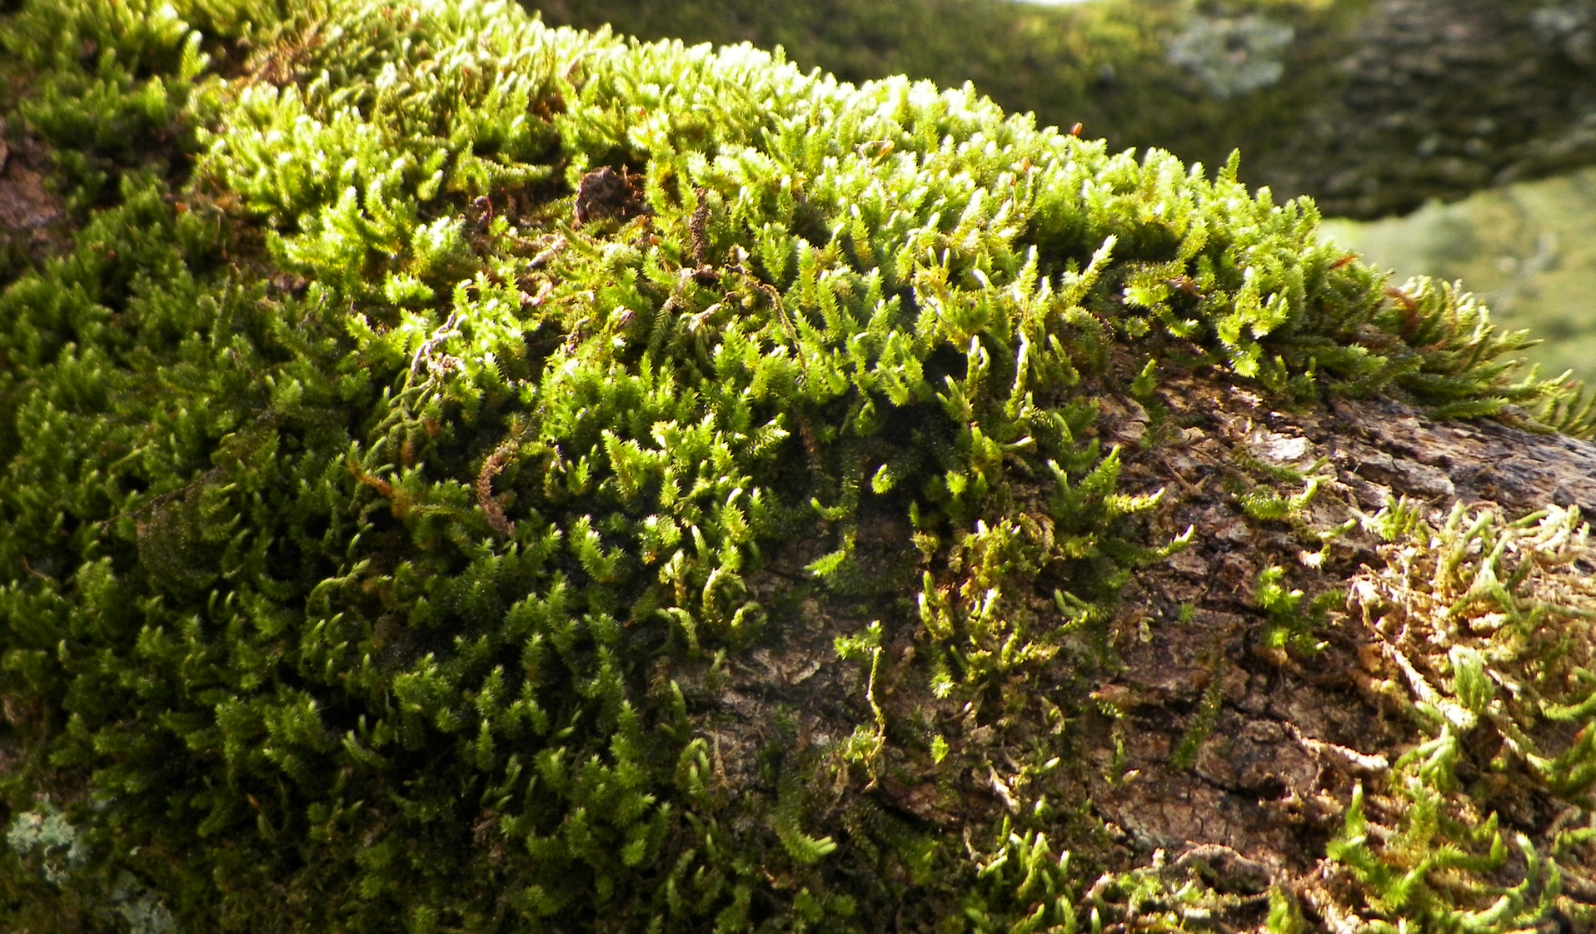
Music In Practice
How, What, and Why?
Notes:
Supporting Youtube playlist: https://youtube.com/playlist?list=PLpIzTlJQrhHuYPn-Dk9STNHKy9l_sZLn2

Slide 2
Definitions
What is a “practice”?
What is a “ritual”?
What differentiates personal ritual from group ritual?
What’s a devotional?
Music (this can mean any number of things!)
Notes:
Practice: the actual application or use of an idea, belief or method (as opposed to theories relating to it)
Ritual: ceremony consisting of a series of actions performed according to a prescribed order; or done as a religious or solemn rite; arising from convention or habit.
Devotional: break down to Devote – to give all or a large part of one’s time or resources to…

Slide 3
How do we use music?
Singing, playing, listening, learning
Incorporate into a formal structure
Call upon it for in-the-moment use
Unite folks and their understanding

Slide 4
Why do we use music?
Creating Liminal Space
What is Liminal Space and why do we want it?
Common Tongue
Unify thought, breath, and focus
Elicit emotion toward catharsis or other release

Slide 5
What music can I use?
Literally Anything *
Chants
Instrumental Music
Popular Music
Sound
*Be aware of Copyright
Notes:
“Do I need permission to ‘perform’ music in a worship service?”
No. You don’t need permission to perform music in worship. This is specifically allowed in copyright law. You cannot record this.
https://www.ucc.org/what-we-do/justice-local-church-ministries/local-church/music-and-liturgical-arts/music-arts_copyright-and-the-church/#:~:text=%E2%80%9CCopyright%E2%80%9D%20is%20the%20legal%20protection,from%20copyright%20law%20for%20churches.

Slide 6
Chants
Are often monotone or very simple
This is for group accessibility
Can support your theme, idea, or just breathing.
Examples:
Air I Am
Mother I Feel You
May the Circle Be Open
Many chants are binary in nature (god/goddess, lord/lady)*
Write your own!

Slide 7
Instrumental / Meditative Music
Used to set mood / tone
Can be used as moving meditations (kinda like Tai Chi)
Examples:
Gobinda Hari or others by Snatum Kaur
Beats Antique
Lindsey Stirling
Any kind of “mood” music (including Dub Step!)
Check out Kevin Wood

Slide 8
Popular Music
Use for pretty much anything.
Move your mind to somewhere else
Create a mood
Drive home a point
Examples:
Ring of Fire (function)
Sound of Silence (mood)
From Now On from Greatest Showman (point)
You Can Still Be Free (astral projection / atmosphere)

Slide 9
More Chant Examples
Circle Setting / Opening
Events / Seasons
We are Circling
We are a Circle
We are a Circle Moving
The Circle is Cast (not a chant)
May the Circle Be Open
Way to the Well (Imbolc)
When We Are Gone (Samhain)
Full Moonlight Dance (duh)
Dark of the Moon (New Moon)
We all Come from the Goddess / Hoof and Horn (Samhain or other harvest)

Slide 10
More Chant Examples 2
Elements
General use
The Earth, The Air… Return
Earth My Body
We Are a Circle (whole song)
Air I Am
When We Are Gone (ish)
She’s Been Waiting
Mother I Feel You
Cauldron of Changes
Earth Song (Turn the World Around)
We are the Flow
Mother of Darkness

Slide 11
More “Pop” Music Examples
General
Christian Songs
I See Fire (Ed Sheeran)
Nexus (Dan Fogelberg)
Are you Ready to Fly? (Dune)
Loreena McKennitt
Sex Magic?
Take me to Church (Hozier)
Enigma’s entire catalog
Be Thou My Vision (Devotional)
May the Circle be Unbroken (Unity)
Oceans (Where Feet May Fail) (Devotional)
Go in Peace (Go in Kindness)

Slide 12
How to use music in Group Ritual
Find a song that fits your need
Learn it
Practice and find a good karaoke track if you’re singing it
Use it to
set a mood
unify a thought
back a meditation
focus energy
for catharsis or other release

Slide 13
Basic Ritual with Music
Play music to set mood as people arrive
Song to open the ritual
Talk about what your ritual will accomplish
Activity to move toward that goal
Song to further move the goal forward
Talk more about the goal and how to move it forward after the ritual
Raise energy (sing, dance, move, focus)
Close Circle (with a song)

